Slide 1
Cu Chi People’s Committee
Phu Hoa Dong Primary School
Online English Learning Chanel

Slide 2
Family and Friends
Special Edition
Grade 5
Ms Danh

Slide 4
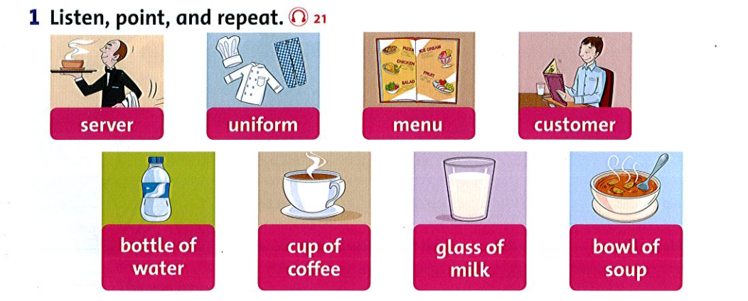
Người
phục
vụ
Đồng
phục
Thực đơn
Kháchhàng
Chai nước
Tách cà phê
Ly sữa
Chén súp

Slide 5
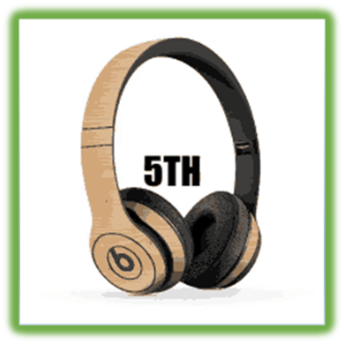
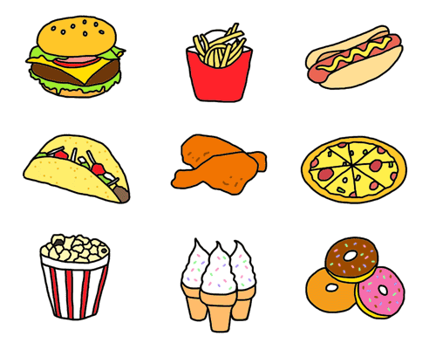
UNIT 3
The food here is great

Slide 6
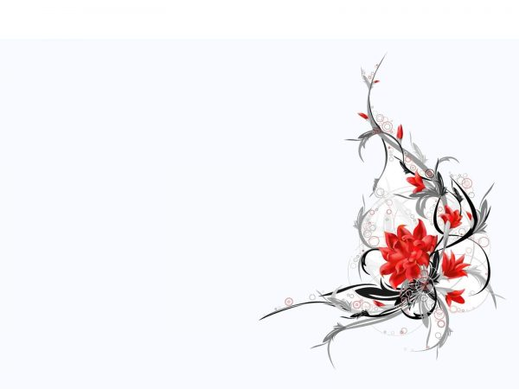
LESSON FOUR
PHONICS
P.23

Slide 7
LISTEN AND POINT

Slide 9
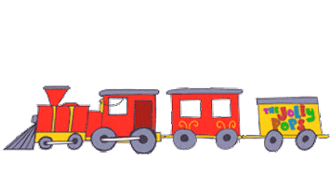
train

Slide 10
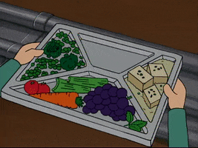
tray

Slide 11
cake

Slide 12
tree

Slide 13
leaves

Slide 14
key

Slide 15
LISTEN AND REPEAT

Slide 16
train

Slide 17
tray

Slide 18
cake

Slide 19
tree

Slide 20
leaves

Slide 21
key

Slide 22
LISTEN AND POINT

Slide 24
Read again. Circle the words with long "a" sounds and underline the words with long "e" sounds.

Slide 25
Circle the word that contains a different vowel sound.
1. train tray tree play
2. cake peas day rain
3. eating seeing playing dreaming
4. leaves key queen same
5. feet tray space rain
6. three please snake easy
7. case race sea lake
8. plane week mean sea

Slide 26
GAME TIME

Slide 27
LISTEN and CHOOSE THE CORRECT WORD.

Slide 28
cake
tray

Slide 29
train
tray

Slide 30
key
cake

Slide 31
key
cake

Slide 32
tree
leaves

Slide 33
tree
tray

Slide 34
GOOD JOB

Slide 35
LESSON FIVE
READING
P.24

Slide 36
What do you eat for breakfast? I have……

Slide 37
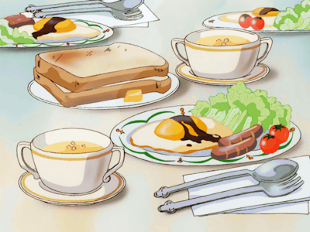
breakfast
Bữa ăn sáng

Slide 38
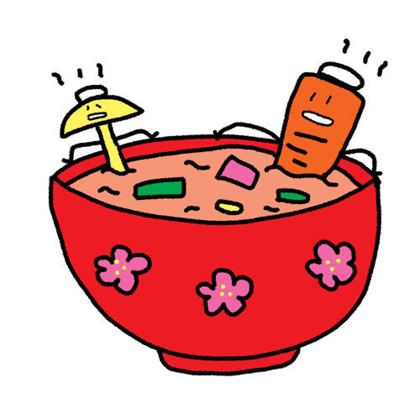
miso soup
Súp miso

Slide 39
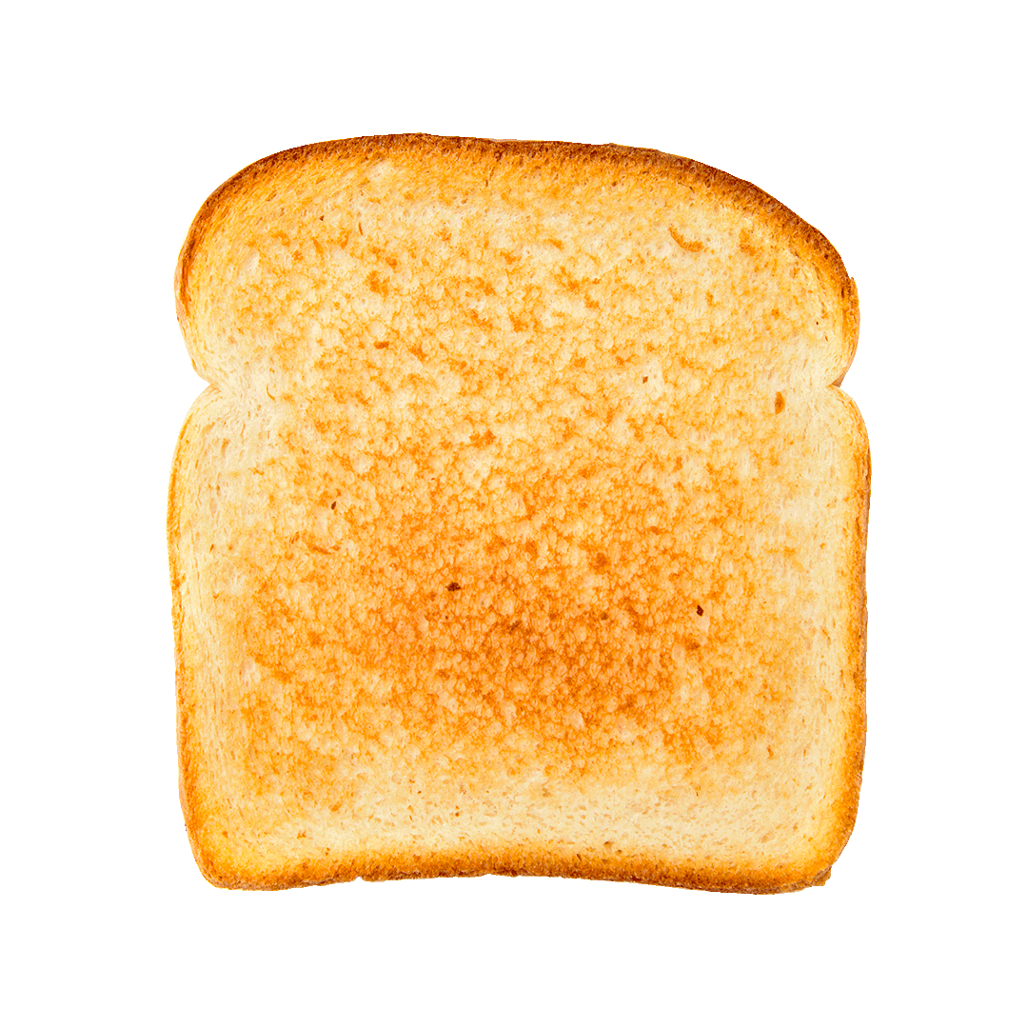
toast
Bánh mì nướng

Slide 40
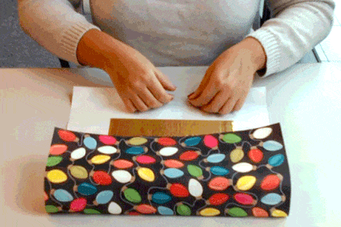
wrap
gói, bọc lại

Slide 41
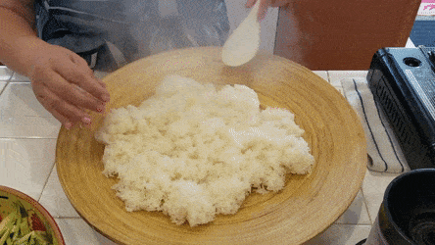
sticky rice
xôi

Slide 42
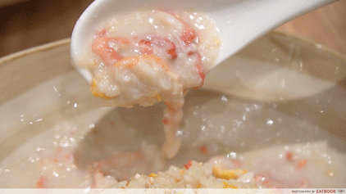
bubur ayam
cháo gà Indo

Slide 43
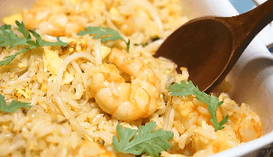
nasi goreng
cơm chiên Indo

Slide 44
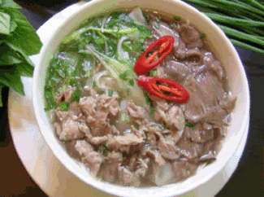
Pho
( Vietnamese noodle soup)

Slide 45
LISTEN AND POINT

Slide 46
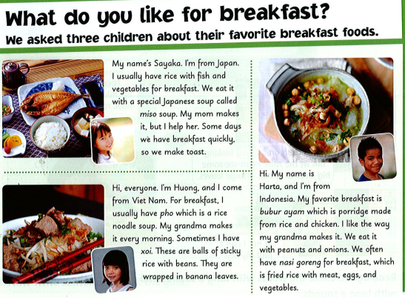

Slide 47
hạt đậu
súp
cháo
bánh mì nướng
đậu phộng

Slide 49
Read again and write J (Japan), V (Vietnam), or I (Indonesia).
1. People have rice and fish for breakfast. _J___
2. People usually have noodle soup. ___
3. Some people have balls of sticky rice with beans wrapped in banana leaves. ___
4. People also eat fried rice with meat, eggs, and vegetables. ____
5. Some people eat toast for a quick breakfast. ____
6. Breakfast is often porridge. ___
V
V
I
J
I

Slide 50
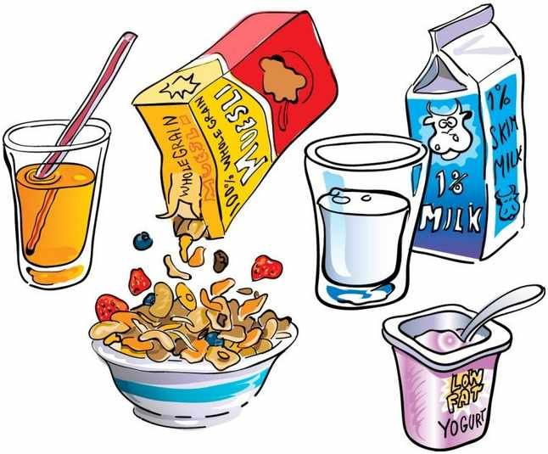
YES or NO
START

Slide 51
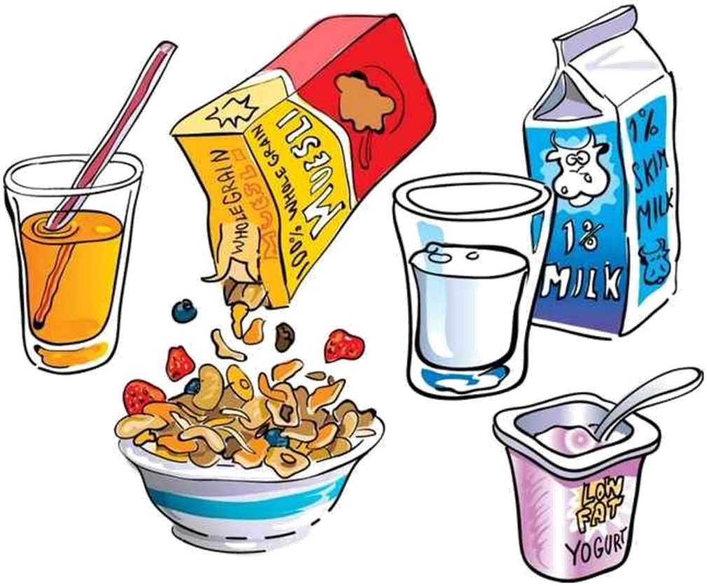
TRUE
FALSE
Sayaka is from Indonesia.

Slide 52
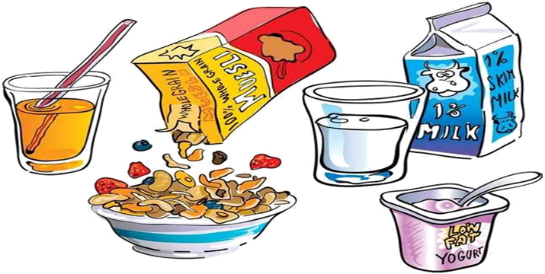
TRUE
FALSE
Sayaka usually has rice with fish and vegetables for breakfast.

Slide 53
TRUE
Sayaka’s grandma makes her breakfast.
FALSE

Slide 54
TRUE
FALSE
Huong usually has pho for breakfast.

Slide 55
TRUE
FALSE
Huong’s grandma makes spaghetti every morning.

Slide 56
TRUE
FALSE
Huong usually has sticky rice for breakfast.

Slide 57
TRUE
FALSE
Harta is from Indonesia.

Slide 58
TRUE
FALSE
Porridge is made from rice and fish.

Slide 59
TRUE
Nasi goreng is fried rice with meat, eggs, and vegetables.
FALSE

Slide 60
LESSON SIX
READING
P.25

Slide 61
Listen and number.
3
2

Slide 62
Listen again and circle the correct word.
3
2

Slide 63
Speaking Ask and answer
1. What do you usually eat for breakfast?
2. What is your favorite meal?
3. Do you go to restaurants with your family?
4. Where do you eat your lunch?
5. What time do you eat dinner?
6. What's your favorite drink?
7. Who cooks in your family?
8. What can you cook?

Slide 64
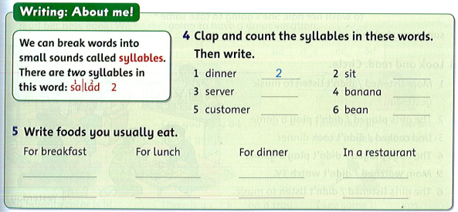
1
squid: con mực
2
3
3
1
Sentinel crab: con ghẹ
pho
rice
rice
king crab
sandwich
Meat/eggs
fish
Lobster: tôm hùm
Fried chicken: gà rán
Hot pot: lẩu

Slide 65
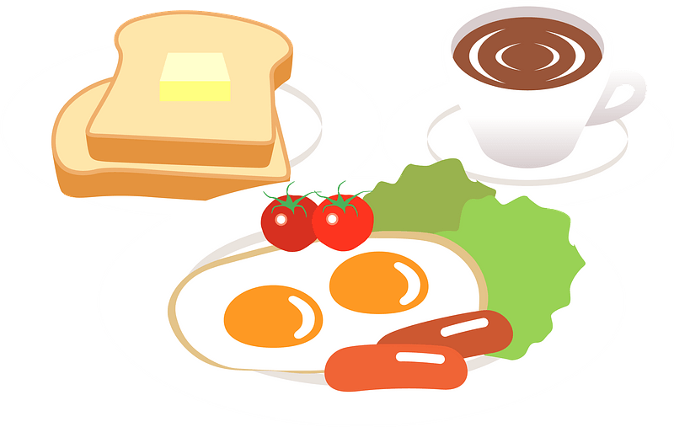
BREAKFAST
QUIZ
START

Slide 66
dinner
This is a meal in a day.
You can eat with your family in the evening.
START

Slide 67
salad
This dish is very good for your health.
There are many kinds of vegetables in it.
START

Slide 68
breakfast
We have this meal in the morning.
START

Slide 69
pizza
This is a kind of fast food.
It’s round. You need to cut it into pieces when you eat.
START

Slide 70
pho
This is Vietnamese noodles soup. It’s very famous and yummy.
START

Slide 71
water
We need this kind of drink every day.
It has no smell, no colors.
START

Slide 72
coffee
This drink is brown or dark brown.
You can add sugar, milk or ice when you have it.
START

Slide 73
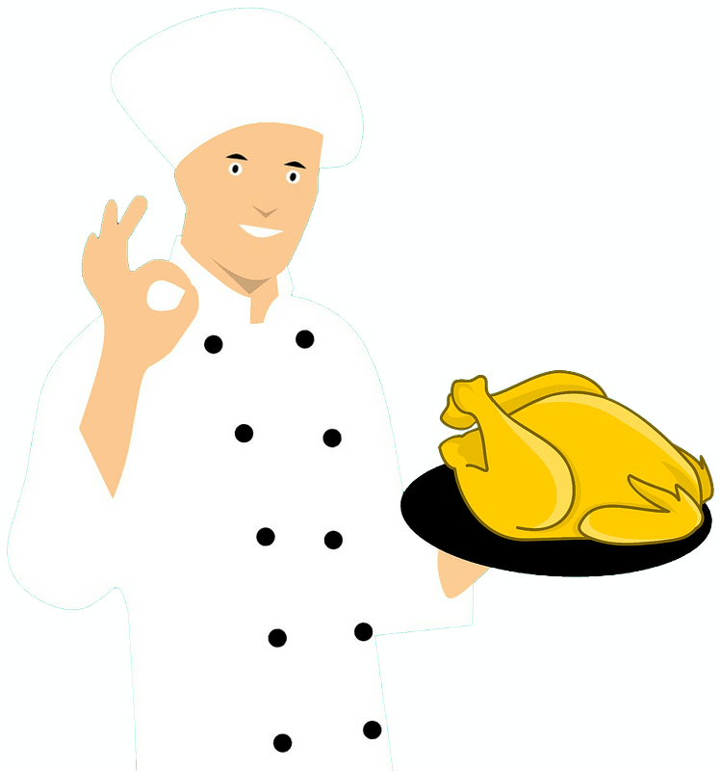
Well done!

Slide 74
GOODBYE!!!

